Slide 1
Exploring locations to open an Italian restaurant in London
IBM Data Science Capstone Project
Pavel Gotovski

Slide 2
Table of contents
1. Introduction
2. Data
3. Methodology
4. Analysis
5. Results and Discussion
6. Conclusion

Slide 3
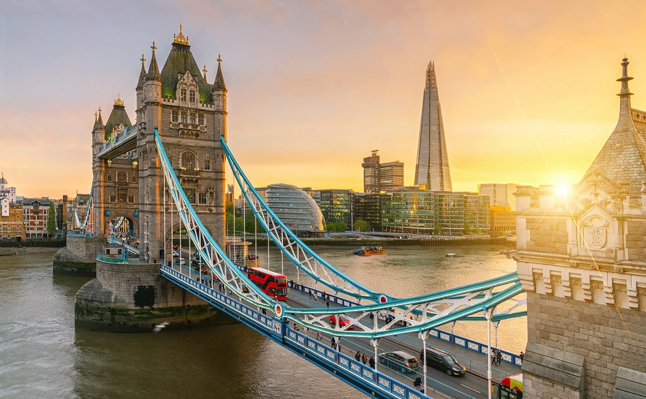
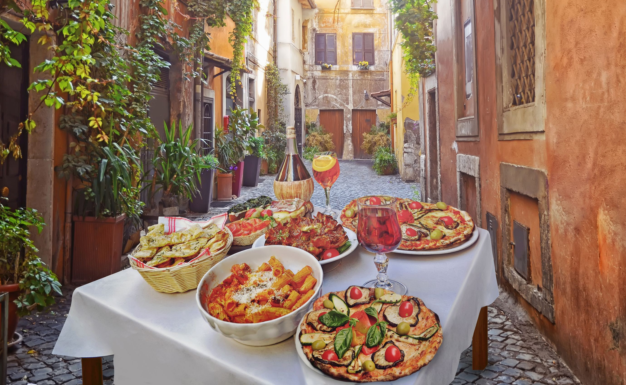

Introduction
London is one of “the world's most visited, most expensive and most influential cities”.
Business problem
“To find the most suitable location(s) to open a new Italian restaurant in London”.

Slide 4
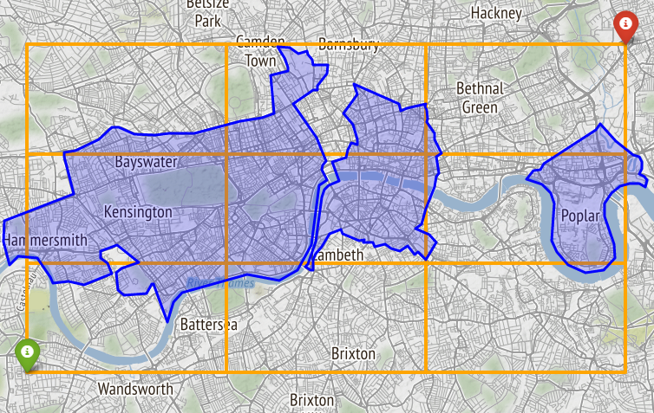
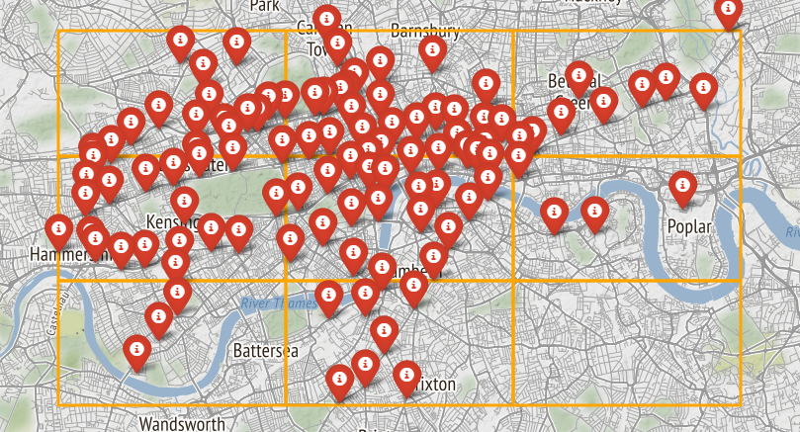
Data
Influential factors:
Regular flow of customers daily.
As few rivals as possible.
Good transportation system.
Possible ideas:
Places in a business district
Places near a metro station

Slide 5
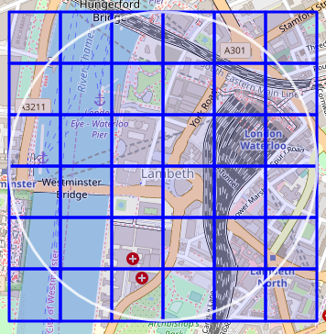
Methodology
Food venue density within ~500 meters from every metro station calculated.
Final candidate area chosen in the lowest density areas.
Potential places within chosen area: locations with no food venues within a radius of 100 meters, and no other Italian restaurant within a radius of 200 meters.
500 m

Slide 6
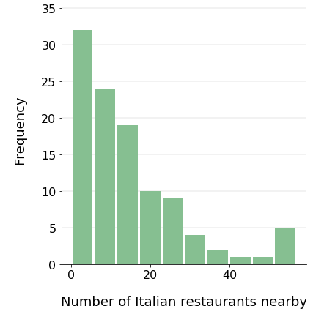
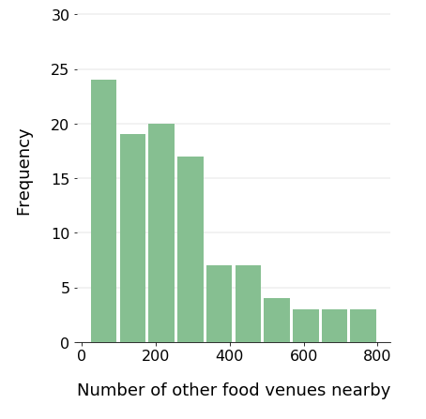
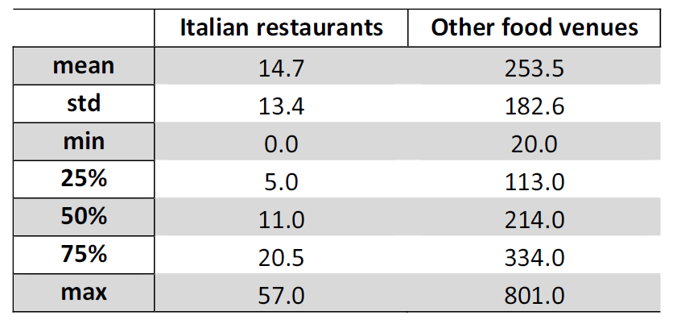
Analysis
On average there are around 14 Italian restaurants and 253 other food venues within the radius of ~500 meters from the stations.
List of potential candidate areas is created based on these criteria:
The number of Italian restaurants is equal or less than 6 (around first quartile).
The number of other food venues is equal or less than 214 (around median).
Total of 32 areas meet the criteria!!!

Slide 7
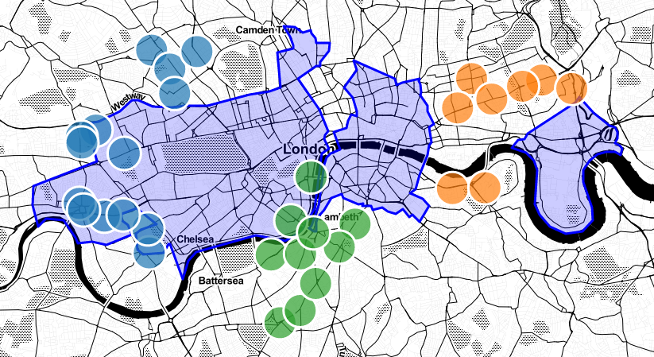
32 possible candidate areas
Final candidate: Pimlico/Millbank area
(chosen based on business densiy nearby)

Slide 8
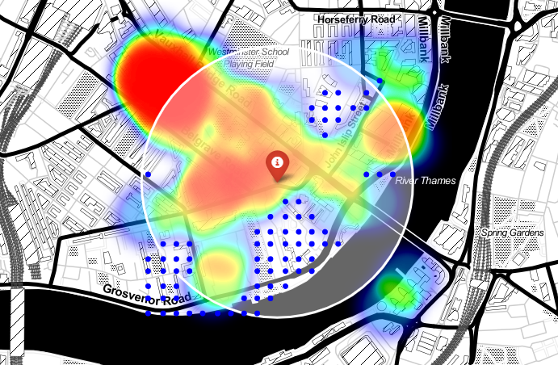
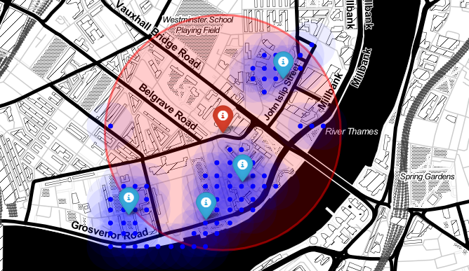
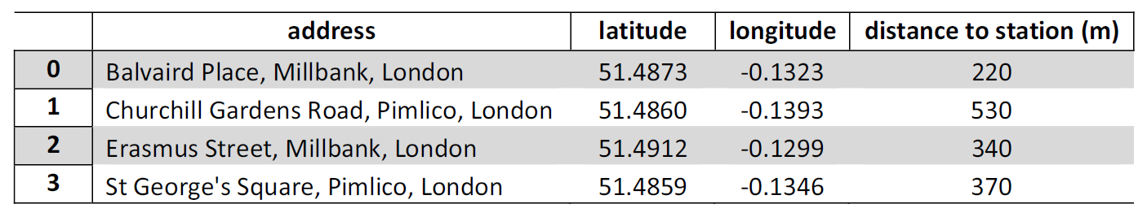
Pimlico/Millbank area
Map of food venue density (rainbow) and potential locations
for a new Italian restaurant (blue dots) around
the Pimlico underground station (red marker).
Zones (blue marker) with a large number of potential
new restaurant places (blue dot) nearby the Pimlico
underground station (red marker).
4 zones identified:

Slide 9
Results
There are 106 underground metro stations in the rectangular area of 16x9 km.
Total of 15084 different food venues (831 of the Italian restaurants) in the vicinity of the stations.
Pimlico/Mill bank areas chosen as final candidate.
Over 4 zones with a large number of potential new restaurant places identified.

Slide 10
Conclusion
A final decision on optimal restaurant location will be made by future investors based on specific factors like proximity to a business center and major roads, rental prices, and other economic variables.

